Slide 1
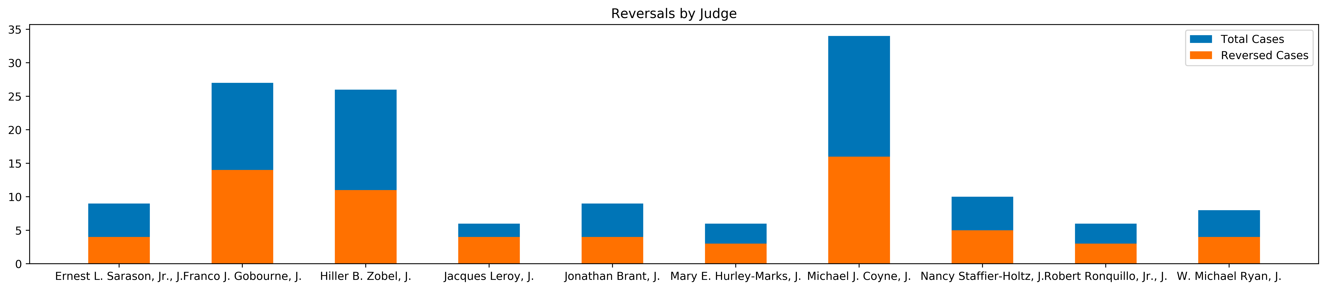
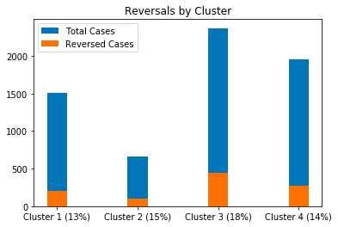
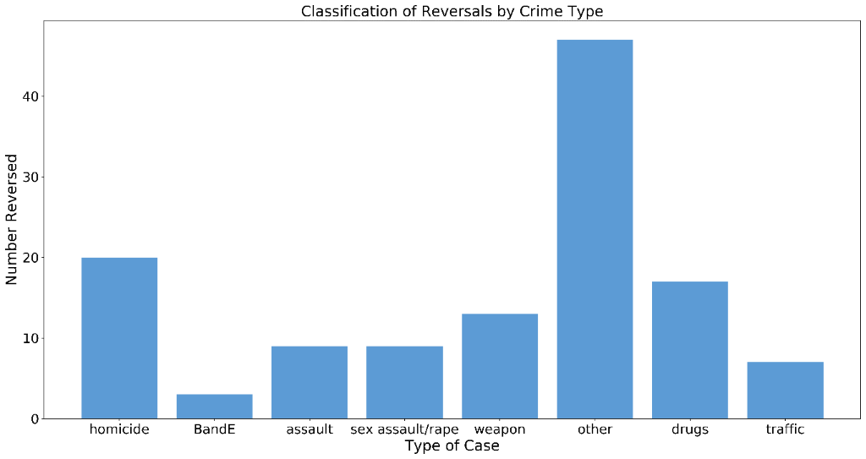
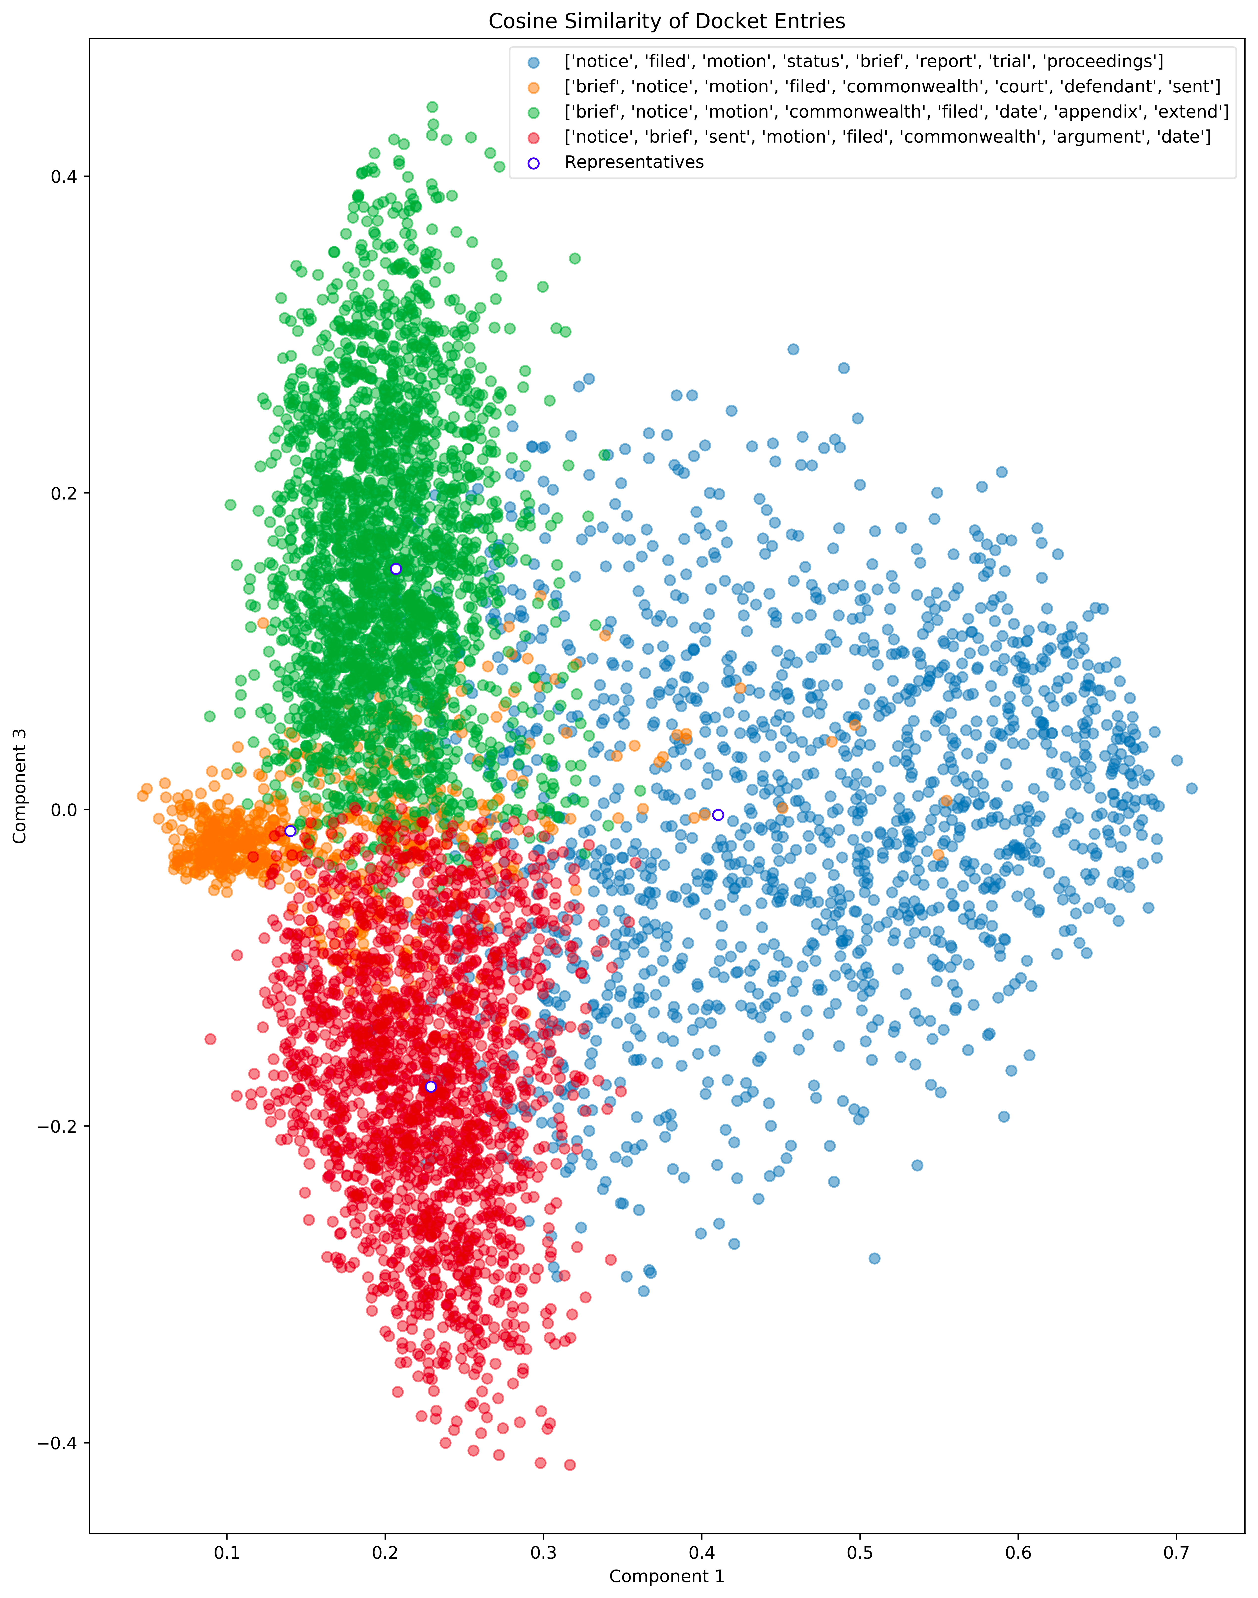
BENCHMARKS: A Citizen’s Scorecard on Judicial Accountability in Massachusetts
James Craver, Samuel Harrison, and Haley Pereira
Spark! Advisor: Professor Maggie Mulvihill
Introduction
Data Continued
Analysis Continued
Conclusions
We worked with BENCHMARKS: A Citizen’s Scorecard on Judicial Accountability in Massachusetts to determine the conditions under which judicial rulings are more or less likely to be reversed. Our work focused on criminal cases appealed to the Massachusetts Supreme Judicial Court and Appellate Courts from 2008–2018. Our goal was to use data science as a tool of investigative journalism to uncover never before-seen patterns of judicial behavior and decision-making in criminal and civil cases.
We then examined individual case summaries scrapped from the Massachusetts Appellate Court Website. From these summaries, we determined how often each lower court judge is reversed. The graph below shows judges who presided over more than five cases and had more than 50% of cases they presided over reversed.
Cluster 1 was defined by stayed cases where court proceedings were halted. Cluster 4 tended to contain cases from 2012-2018, while Cluster 3 contained cases from 2008-2011. 2010 had an unusually high percent of appealed cases reversed. This most likely explains why the reversal percentage of Cluster 3 is higher than the other clusters.
We found that on average 14% of court cases appealed in Massachusetts are reversed each year. Analysis of case docket entries determined which cases were reversed, allowing us to examine reversed cases for similarities. We obtained basic information about each case from its summary in order to determine how often each lower court judge is reversed, revealing that some judges are reversed more often than others. Analysis of published opinion texts revealed that homicide is the crime most likely to be reversed, followed by drug crimes. Nevertheless since not every case has a published opinion, further analysis must be done to determine if we have a representative sample before we can reach a definitive conclusion about the relationship between case reversal and crime type. All data currently available to the public, however, suggests it has an effect.
Questions
Judges with a reversal ratio of greater than 50%
What proportion of cases are reversed in Massachusetts?
What are the similarities between cases that are reversed?
Are there certain types of crimes that are reversed more than often than others?
What factors are most strongly correlated with the reversal of a criminal conviction?
While the summary text provides general information about each case, it lacks specific information necessary for detailed analysis of reversals in Massachusetts. Therefore, we downloaded the full opinion text of each reversed case over the last decade from the Massachusetts Appellate Opinion Portal. Unfortunately, only 9-12% of cases each year have published opinions. More information about the published opinion text is located under Analysis.
Percent of cases reversed by cluster
Analysis of case opinion text yielded more meaningful results than analysis of docket entries. By searching for key terms such as “homicide” and “firearm” in the headnotes of each page, we classified each case by type of crime.
Future Steps
Benchmarks is an ongoing project spanning multiple semesters and departments at BU. While we developed a strong foundation for the project, there is still work to be done to uncover trends in the Massachusetts judicial system. Since we were limited to published opinion texts, our conclusions were limited. Future groups petitioning the court system may be able to gain access to all opinions, resulting in more significant conclusions. Additionally, the data we found could be correlated with other data sources such as demographic information which could reveal biases in the court system. Going forward this project will hopefully be a valuable check on court accountability.
Data
Analysis
From our analysis of each case’s docket entry, we grouped cases into four clusters based on their cosine similarity. Cluster 1 had the lowest reversal rate, while Cluster 3 had the highest, as shown in the chart located in the next
column. Although we removed numbers from our analysis to prevent a time bias, some clusters appear to be defined by year. Cluster 2 was an exception, containing all Supreme Judicial Court cases.
Ratio of appealed cases reversed from 2009-2017
We first considered the Annual Report on the State of the Massachusetts Court System from 2009 to 2017. From these reports we were able to determine the number of cases appealed each year and find the ratio reversed.
Number of reversed cases by type of crime
Crimes classified under “Homicide” were the most likely to be reversed, followed by those classified as “Drugs” and “Weapon,” while those classified as “Breaking and Entering” were the least likely.
Acknowledgements
Cluster analysis of docket entry text
We would like to thank Maggie Mulvihill and Ziba Parissa for sponsoring a Spark! Project.

